Slide 1
Introduction to Neural Network
Presenter: Dr. Umarani Jayaraman, IIITDM Kancheepuram
18th Aug 2021

Slide 2
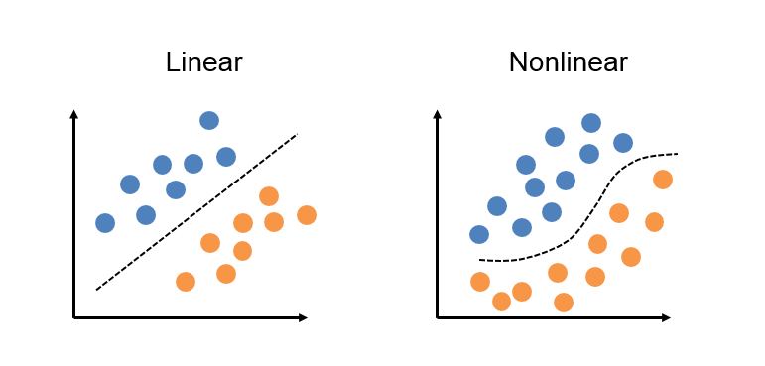
Linear and non-linear classifier
Linear Classifiers- Perceptron, SVM
Non linear cases it minimize sum of squared error.

Slide 3
Linear and non-linear classifier
The existing approaches such as perceptron and SVM are assumes for linearly separable classes
But, for non-linearly separable cases it ensures the minimum error rate [sum of squared distance]

Slide 4
Neural Networks
Motivation- why neural networks?
Introduction
Single Layer Perceptron
Multiple Layer Perceptron
Example

Slide 5
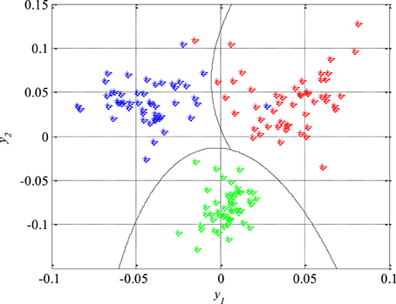
Non linear classifier
The most non linear classifiers are
Quadratic classifier
Cubic classifier

Slide 6
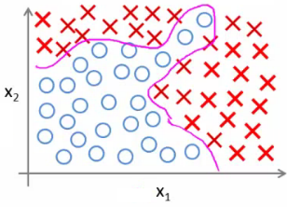
Complex nonlinear decision boundary
The decision boundary is so complicated and it becomes much more complicated if the number of classes becomes more than two
The kind of approach, that people take in such complicated cases is to make use of neural networks

Slide 7
Complex nonlinear decision boundary(2)
Though it is a complicated non linear decision boundary we can have a piece wise linear approximation of straight line as below
A neural network in the simplest form actually tries to form a collection of such straight line boundaries

Slide 8
Complex nonlinear decision boundary(3)
Collection of such straight lines actually model such complicated non-linear decision boundary

Slide 9
What does neural networks have?
Output layers
None or more no of hidden layers
Input layer

Slide 10
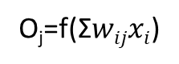
What does neural networks have?
O_{j}=f(Σ$wijxi$)
o_{j}
w_{ij}
x_{i}

Slide 11
Neural Networks
It is a computational model which tries to approximate the biological neural networks in the human brain
Biological neural networks consists of number of cells (neurons). A neuron consists of dendrites, cell body and axon

Slide 12
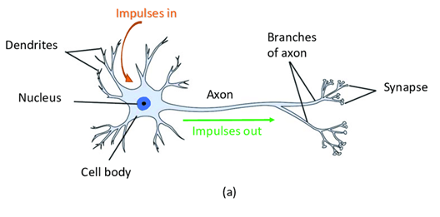
Biological Neuron
The dendrites act as sensors that sense different stimulus through sense organs
The region of the neuron containing the nucleus is known as the cell body,
Signal is carried through axon to neighboring neurons
Depending upon what kind of stimulus the dendrites sense, the brain takes particular action or decides the action and send that information to different part of the body to complete the action.

Slide 13
Neural networks
A neural network tries to imitates the functionality of something like this
A neuron model for machine intelligence is
Dendrites
x₁
w₁
Cell body
Axon
x₂
w₂
Σ
f
w₃
Y(output)
x₃
w_{n}
x_{n}
A node

Slide 14
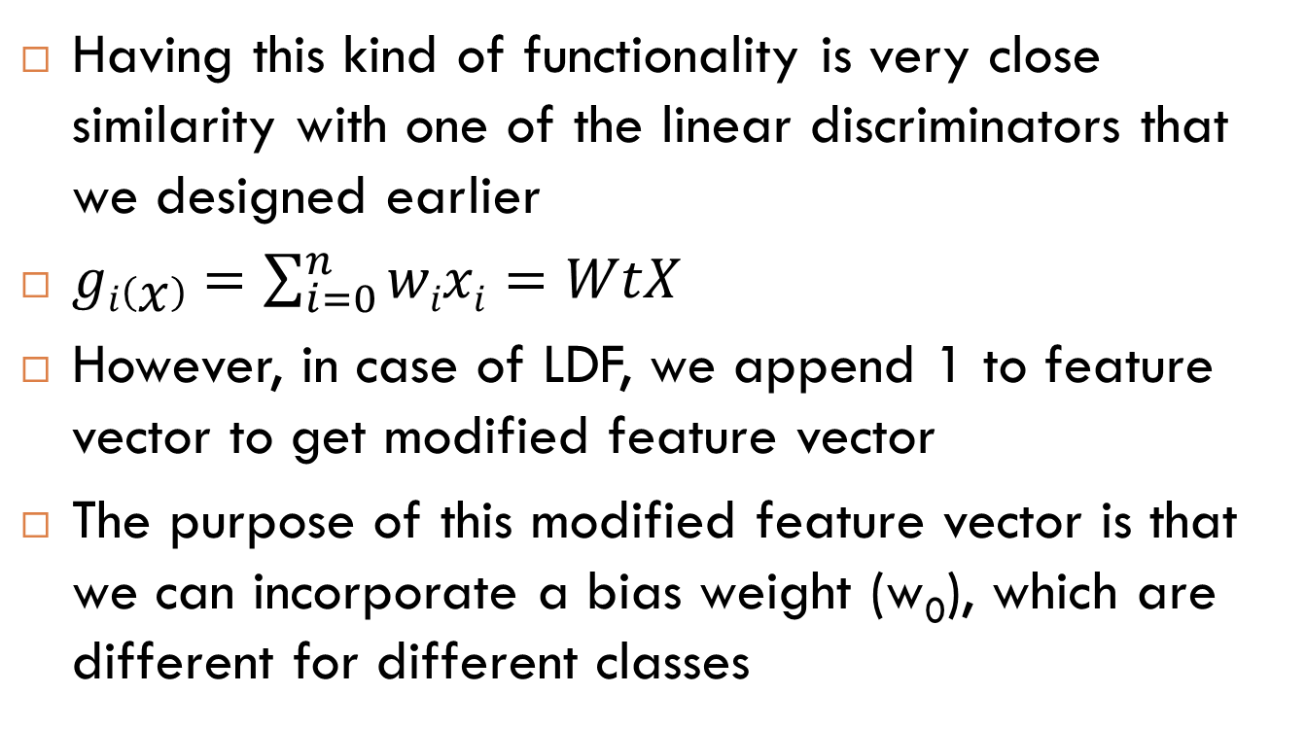
Neural networks
Having this kind of functionality is very close similarity with one of the linear discriminators that we designed earlier
$gi\left(x\right)=\sum_{i=0}^{n}{wixi}=WtX$
However, in case of LDF, we append 1 to feature vector to get modified feature vector
The purpose of this modified feature vector is that we can incorporate a bias weight (w₀), which are different for different classes

Slide 15
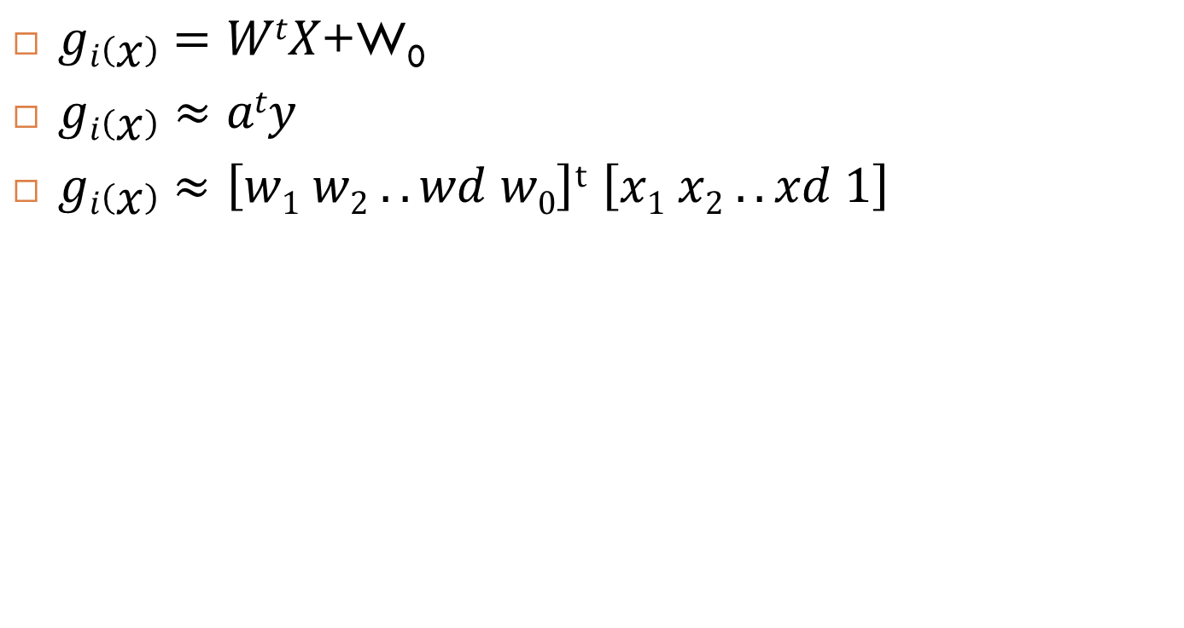
Neural networks
$gi\left(x\right)=WtX\text{+}\text{W}\text{0}$
$gi\left(x\right)$ $≈aty$
$gi\left(x\right)≈\left[w1 w2 ..wd w0\right]t$ $\left[x1 x2 ..xd 1\right]$
x₁
w₁
x₂
w₂
Σ
f
Y(output)
w_{d}
x_{d}
w₀
1
A node

Slide 16
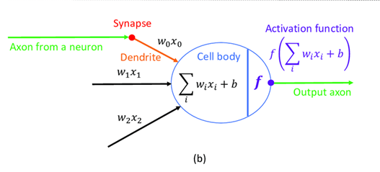
Neural networks

Slide 17
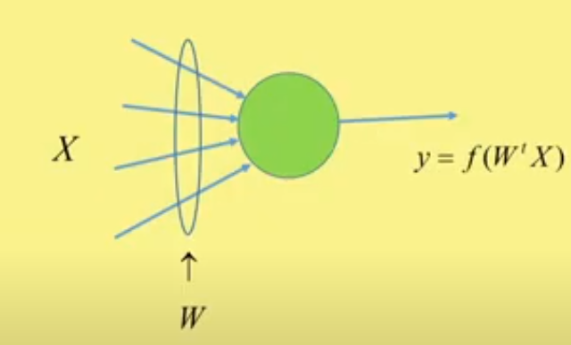
Neuron or node in Neural Network
A node
The aim is to select the proper weight vectors which can classify two or more classes correctly

Slide 18
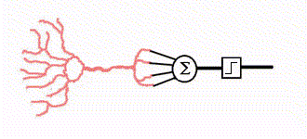
Neural Networks
Function of neural networks
As it is very close to perceptron criterion, a neural network formed out of such neuron model is also called as perceptron

Slide 19
Neural Networks
In the simplest case, we can have a single output single layer perceptron which is nothing but a single neuron or a single node in neural network

Slide 20
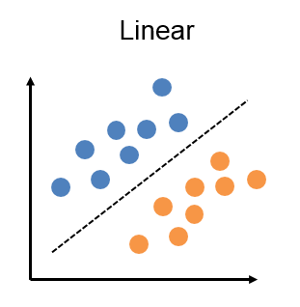
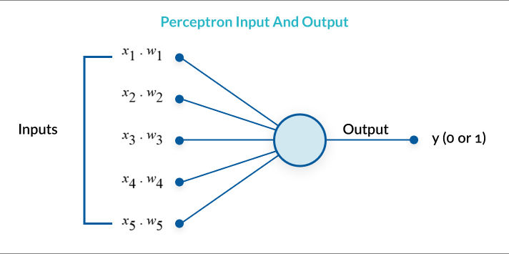
Single layer single output - Perceptron
Also called as single layer perception with one neuron
Good for linearly separable cases (binary classification)

Slide 21
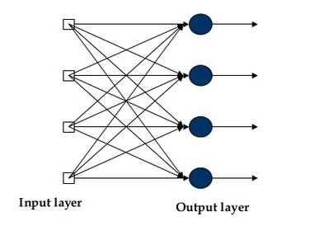
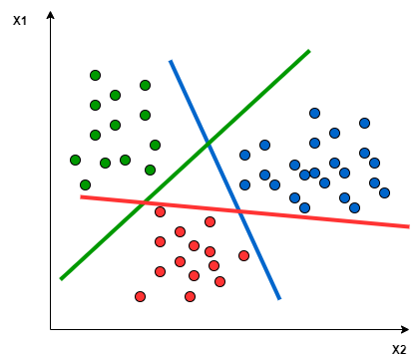
Single layer multiple output NN
Also called as single layer perception with 4 neurons
Good for linearly separable cases (Multiclass)

Slide 22
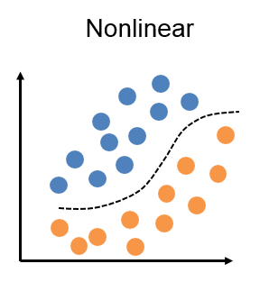
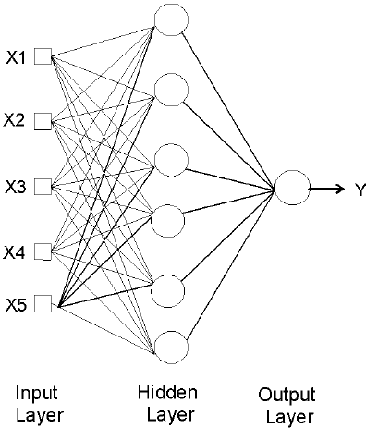
Multiple layer single output NN
Also called as multilayer perceptron (MLP)
Good for non linearly separable cases (binary)
We use sigmoid as non linear function

Slide 23
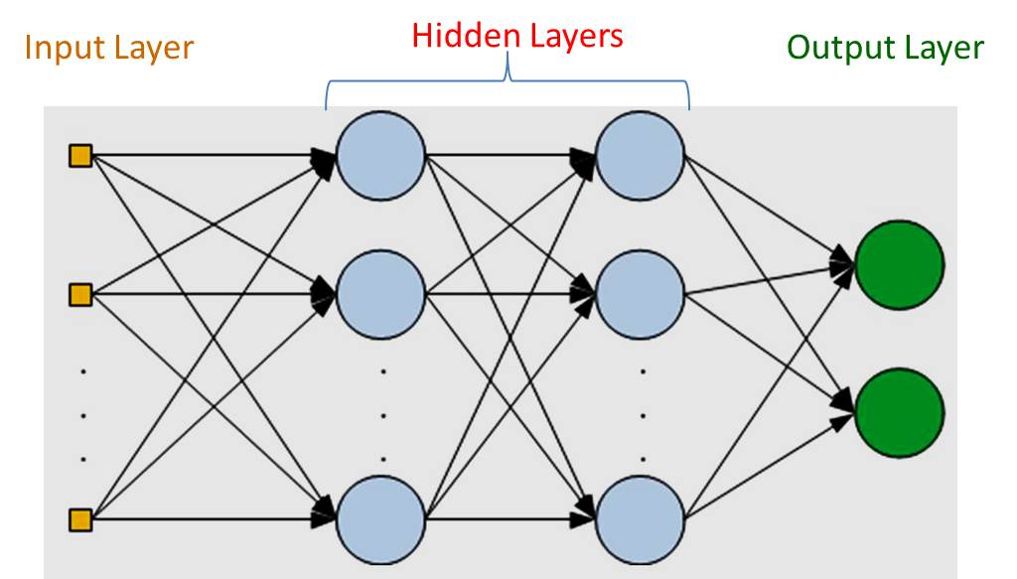
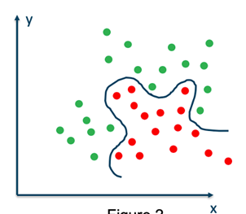
Multiple layer multiple output NN
Also called as multilayer perceptron (MLP) or artificial neural network (ANN)
Good for non linearly separable cases (multiclass)
Non linear

Slide 24
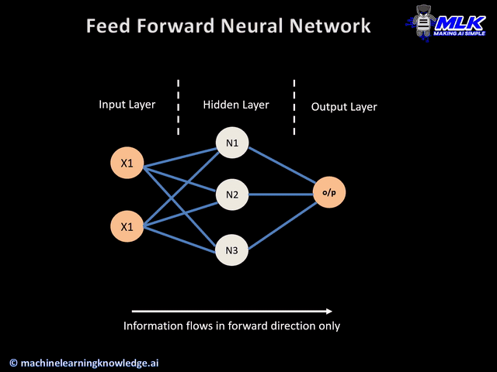
Feed forward neural network
MLP

Slide 25
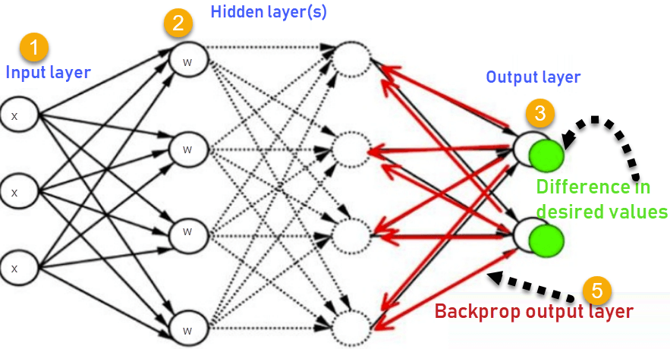
Back propagation learning algorithm
MLP

Slide 26
What to do?
The goal is to set the error function or loss function ‘E’
Minimize the loss function using gradient descent approach by updating the weight vectors
Find the weight updation rule for output layer and hidden layer

Slide 27
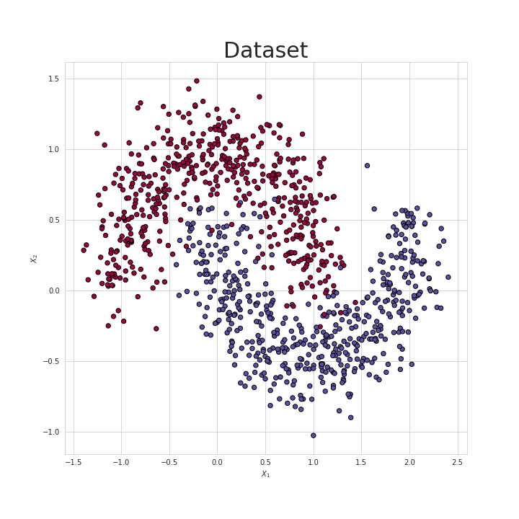
MLP output
https://towardsdatascience.com/lets-code-a-neural-network-in-plain-numpy-ae7e74410795

Slide 28
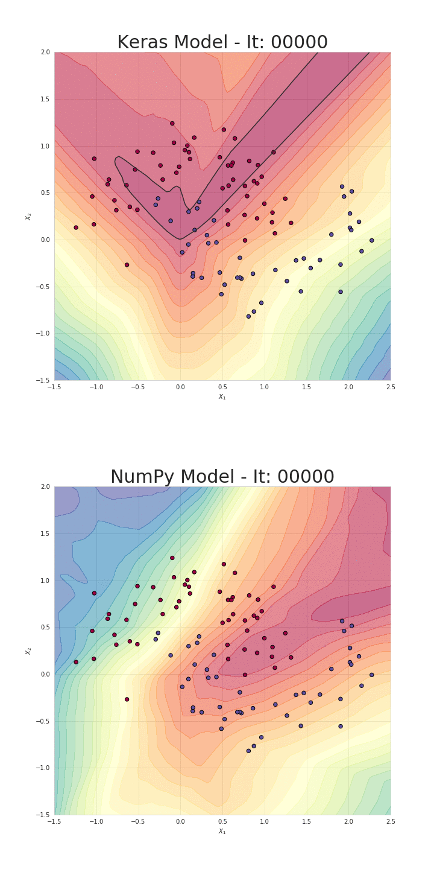
MLP Output

Slide 29
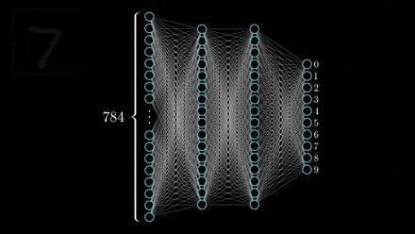
MLP-example

Slide 30
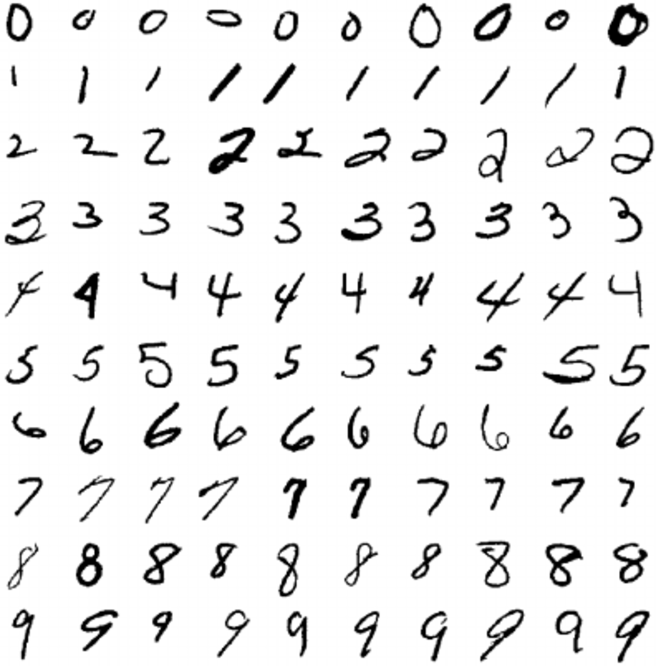
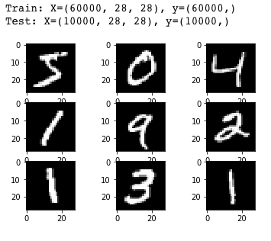
MNIST Dataset

Slide 31
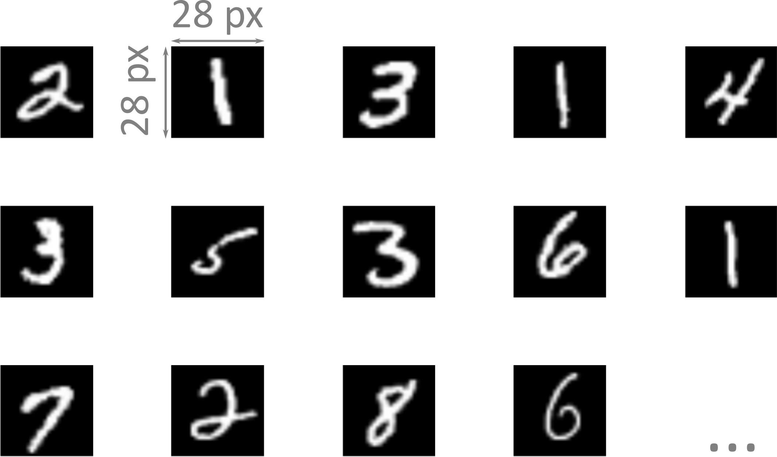
MNIST Dataset

Slide 32
Thank you

